Slide 1

AUDIO-to-text alignment for non-dominant languages SIL International

Slide 2



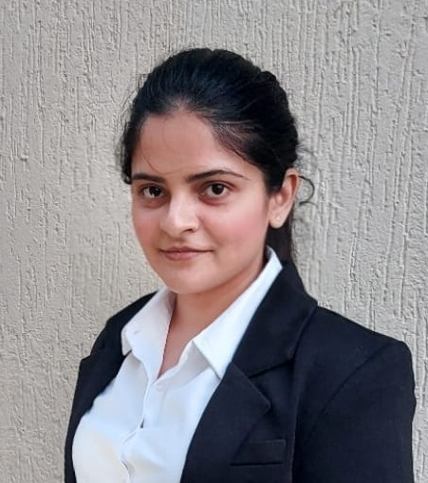


The Team
Chinmay Gidwani
Email: xxx
LinkedIn: xxx
Keertana Madan
Email: madank@purdue.edu
LinkedIn: www.linkedin.com/in/keertanamadan/
Prathyusha Reddy
Email: pmidudhu@purdue.edu
LinkedIn: https://www.linkedin.com/in/prathyusha-reddy-616316219/
Kavyasri Jadala
Email: kjadala@purdue.edu
LinkedIn: www.linkedin.com/in/kavyasri-jadala/
Anupama M
Email: m1@purdue.edu
LinkedIn: www.linkedin.com/in/anupama-m

Slide 3

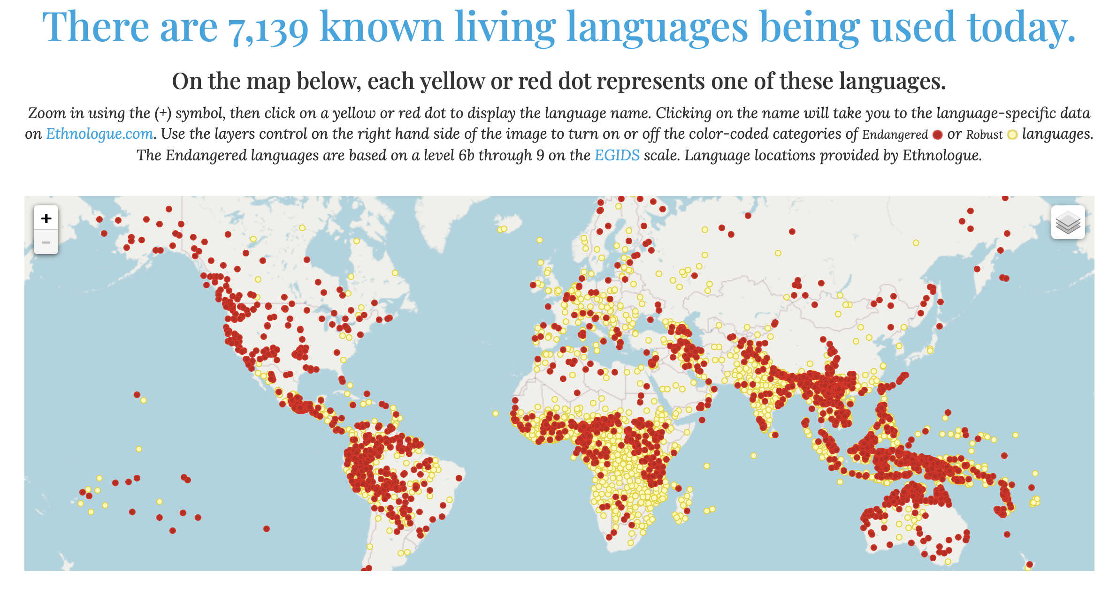
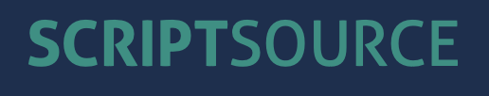
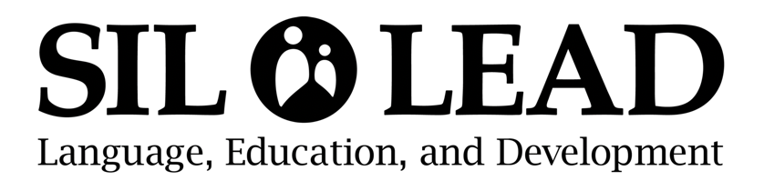

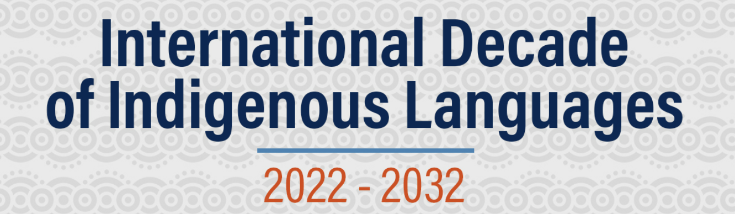



SIL International
Writing Systems
World Language Map
Educational Empowerment
Language Codes
Language for Development
Global Languages
Jonathan Hudlow
Senior Data Scientist
Joshua Nemecek
Data Scientist
Notes:
SIL International (then known as the Summer Institute of Linguistics) began in 1934 as a summer training program in Arkansas, USA, with two students.
Achieved numerous milestones and received numerous awards in the field of linguistics
1. ScriptSource is a dynamic, collaborative reference to the writing systems of the world, with detailed information on scripts, characters, languages - and the remaining needs for supporting them in the computing realm.
2. SIL LEAD is a faith-based nonprofit helping local, community-based organizations use their own languages to improve their quality of life.
3. ISO 639 gives comprehensive provisions for the identification and assignment of language identifiers to individual languages, and for the creation of new language code elements or for the modification of existing ones
4. IDIL, or International Development in Language, is an initiative by SIL that focuses on leveraging language development as a means to support international development goals. It aims to integrate language strategies into broader development efforts to enhance effectiveness and sustainability.
5. Ethnologue provides comprehensive data on the languages of the world, including information on language status, speaker numbers, and geographical distribution.

Slide 4




Story Flow
01
Business Problems & Benefits
02
Project Scope
AGENDA
03
Data Overview
04
Methodology

Slide 5



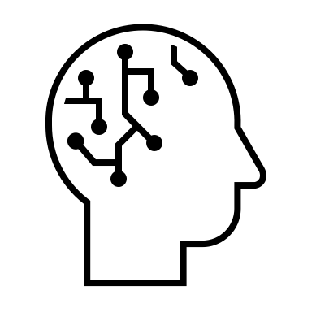
Story Flow
05
Model Approach
06
AGENDA
Results & Recommendations
07
Challenges
08
Future Scope

Slide 6
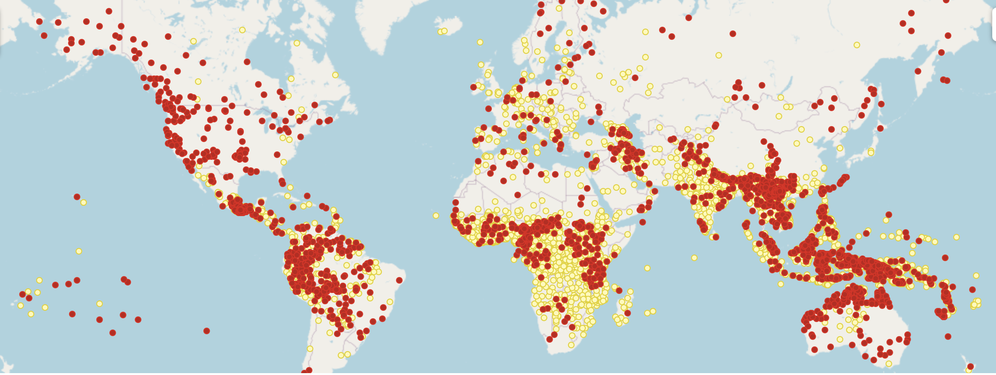







Business Problem
Audio Data
Localisation
Aligning Audio with Text
Speech Tech
Accessibility constraints for Non-Dominant language speaking communities
Advertisements
Text Data
Notes:
Localization – Localization involves adapting digital content, software, and applications to meet the linguistic, cultural, and technical needs of users in different regions.
Speech Tech – The project enhances speech technology by improving the accuracy of speech recognition and text-to-speech systems for underrepresented languages.
Advertising – In advertising, the project can tailor marketing messages to resonate more deeply with local audiences by accurately translating and aligning audio and text content across languages.

Slide 7
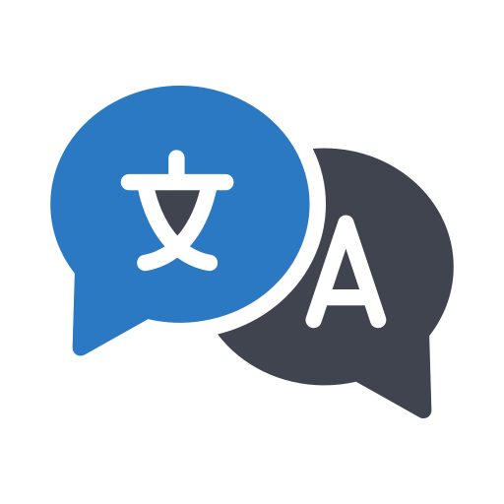





Benefits
Direct Impacts
Translation Tools
Educational Material Creation
Customized Learning Tools
Broader Impacts
Enhanced Language Accessibility and Inclusivity
Improved Accuracy in Multilingual Contexts
Positive Social Impact
Notes:
Translation Tools: Improved audio-to-text alignment technology can enhance machine translation systems, aiding SIL's translation projects, including scriptural and educational materials.
Educational Material Creation: Converting spoken educational content into text can enrich educational resources available in endangered and lesser-known languages.
Customized Learning Tools: The project's outputs can be used to develop language learning applications and tools tailored to specific linguistic needs.
Enhanced Language Accessibility and Inclusivity: By developing more effective language alignment tools and methodologies, SIL can significantly improve access to services and information for individuals in non-dominant language communities.
Improved Accuracy in Multilingual Contexts: Successfully aligning audio-to-text in multilingual settings can enhance the accuracy of scripts in multinational productions, which is crucial for SIL's work in diverse linguistic environments.
Positive Social Impact: The successful completion of this project aligns with SIL's overarching goal of positive social impact, particularly in education, healthcare, and other critical areas where language plays a key role.

Slide 8



Project Scope
Aim to establishing how much data is needed to train the alignment model to achieve high accuracy.
Focusing on monotonic, monolingual audio from datasets like Mozilla Common Voice.
Innovation lies in the method of generating phonemes from audio and aligning these with tokenized text, potentially requiring less data than conventional speech recognition technologies.

Slide 9
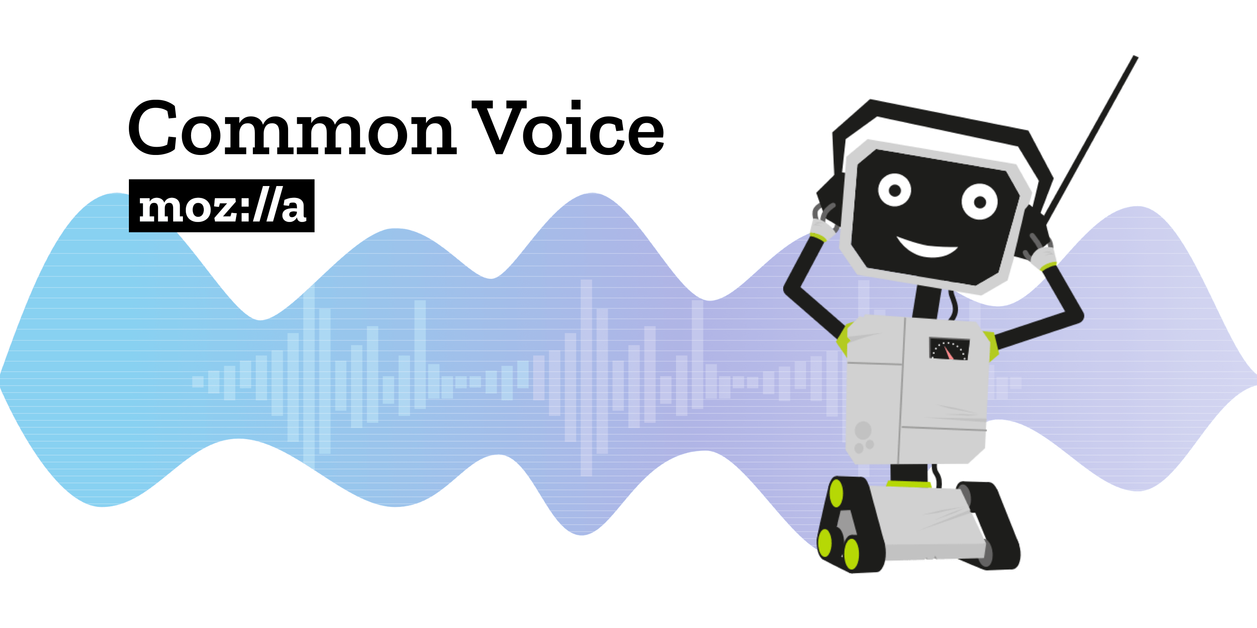

Data Overview
Characteristics
- Language Diversity: Covers a 120+ wide range of languages, including low-resource languages.
- Format: Includes both audio and text transcriptions.
Purpose
- Audio-Text Alignment: To develop and test methodologies for aligning spoken words with written text.
- Cross-lingual Analysis: Facilitates experimentation in mono-lingual and cross-lingual contexts.
Languages
English
Hindi
French
Mozilla Common Voice
Recordings of various languages (monolingual)
Europarl-st
Multilingual European Parliament proceedings

Slide 10
Methodology
Downloaded the audio files and analyzed the different audio files
Audio files were converted to tokens
Align the phonemes and tokens with the text transcriptions
Install Packages
Phonetization
Wave2Vec2, Eflomal packages configuration & installation on local
Generated phonemes of the input audio files
Dataset Analysis
Tokenization
Alignment

Slide 11


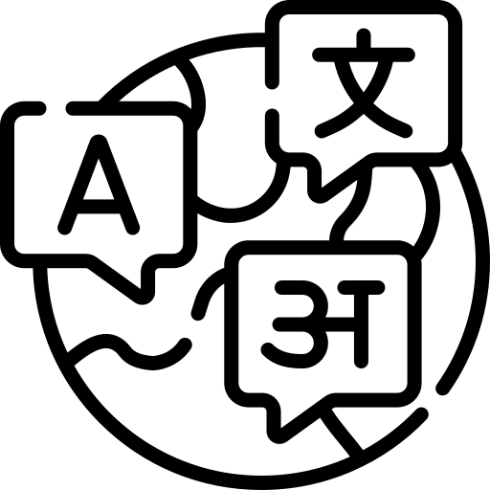

SentencePiece
How SentencePiece transforms text data
Key Features
Lossless Tokenization
Sub-word Segmentation
Language Agnostic
Workflow
Training
Tokenization
Detokenization
Advantage Over Traditional Tokenizers: Handles rare/unfamiliar words by breaking them into known segments, unlike traditional methods that might misinterpret or omit them.
Notes:
Lossless Tokenization: Maintains original text integrity, ensuring no data loss.
Subword Segmentation: Breaks down words into smaller, manageable units.
Language Agnostic: Effective across multiple languages.
Training: Learns to segment text from a large corpus.
Tokenization: Splits text into subwords or characters based on training.
Detokenization: Reconstructs original text from tokens.
"Antidisestablishmentarianism" → Split into "anti," "dis," "establish," "ment," "arian," "ism".

Slide 12
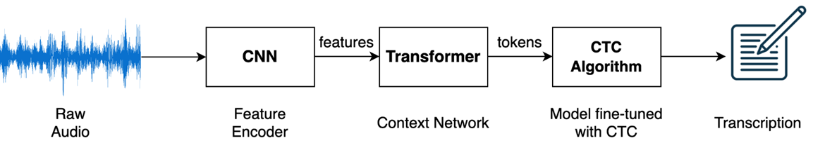
Wav2Vec2
How Wav2Vec2Phoneme transforms Audio data into Phonemes
Advantage Over Traditional Tokenizers: Is language agnostic and converts audio data into sounds(phonetic) tokens.
Notes:
Lossless Tokenization: Maintains original text integrity, ensuring no data loss.
Subword Segmentation: Breaks down words into smaller, manageable units.
Language Agnostic: Effective across multiple languages.
Training: Learns to segment text from a large corpus.
Tokenization: Splits text into subwords or characters based on training.
Detokenization: Reconstructs original text from tokens.
"Antidisestablishmentarianism" → Split into "anti," "dis," "establish," "ment," "arian," "ism".

Slide 13
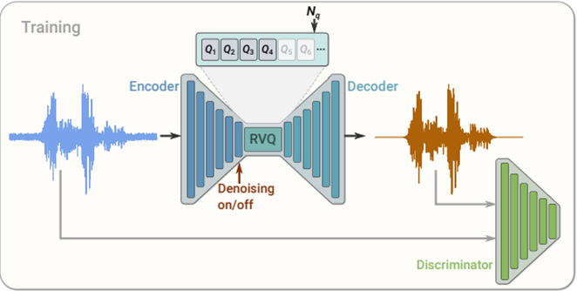
SoundStream
How Soundstream transforms Audio data
Advantage Over Wav2Vec2phoneme : Wave2vec2 phoneme typically produces about 300 output tokens, which contrasts with SoundStream's larger and adjustable token dictionary. However, the application of wave2vec2 phoneme is limited by its training scope, which does not encompass all languages. Consequently, we may need to consider SoundStream for broader linguistic coverage or demonstrate the effectiveness of wave2vec2 phoneme in languages it was not explicitly trained on.
Notes:
Lossless Tokenization: Maintains original text integrity, ensuring no data loss.
Subword Segmentation: Breaks down words into smaller, manageable units.
Language Agnostic: Effective across multiple languages.
Training: Learns to segment text from a large corpus.
Tokenization: Splits text into subwords or characters based on training.
Detokenization: Reconstructs original text from tokens.
"Antidisestablishmentarianism" → Split into "anti," "dis," "establish," "ment," "arian," "ism".

Slide 14
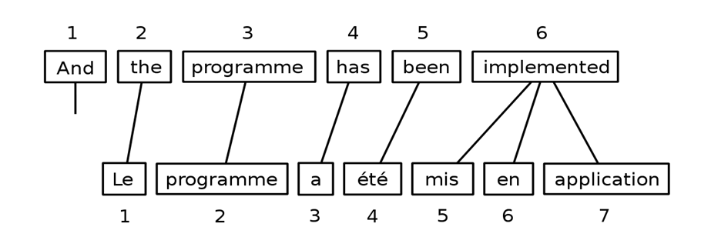
Eflomal
How Eflomal aligns text data
Advantage Over Traditional Tokenizers: Has the least alignment error rate as compared to other aligners available.
Notes:
Lossless Tokenization: Maintains original text integrity, ensuring no data loss.
Subword Segmentation: Breaks down words into smaller, manageable units.
Language Agnostic: Effective across multiple languages.
Training: Learns to segment text from a large corpus.
Tokenization: Splits text into subwords or characters based on training.
Detokenization: Reconstructs original text from tokens.
"Antidisestablishmentarianism" → Split into "anti," "dis," "establish," "ment," "arian," "ism".

Slide 15
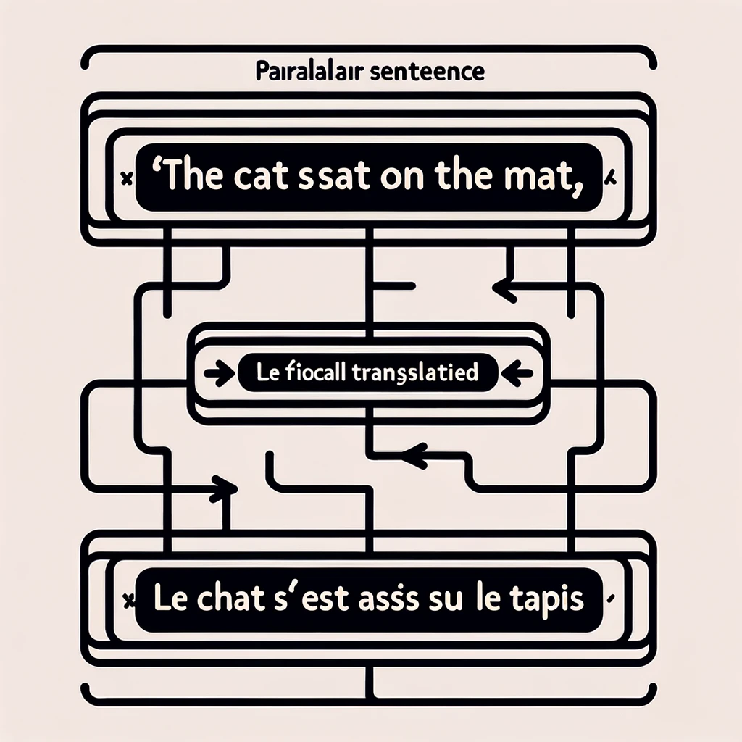
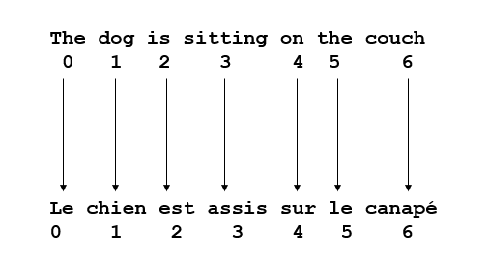
SimAlign
How Simalign aligns text data
Limitation compared to Eflomal: It has poorer performance compared to Eflomal for lesser known languages.
Notes:
Lossless Tokenization: Maintains original text integrity, ensuring no data loss.
Subword Segmentation: Breaks down words into smaller, manageable units.
Language Agnostic: Effective across multiple languages.
Training: Learns to segment text from a large corpus.
Tokenization: Splits text into subwords or characters based on training.
Detokenization: Reconstructs original text from tokens.
"Antidisestablishmentarianism" → Split into "anti," "dis," "establish," "ment," "arian," "ism".

Slide 16
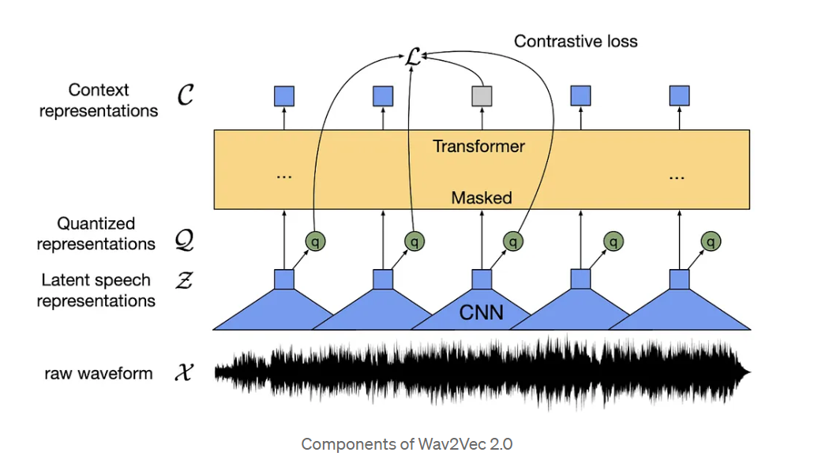
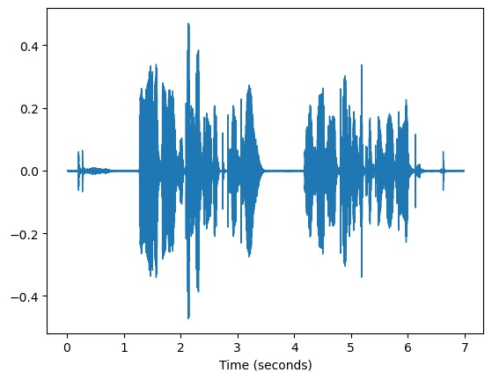

Model Deployment –Audio to transcript
STEP-1: Tokenization
Model | Trained model | Sample Lanugage | Duration
Wav2Vec 2.0 Base | XLSR-53 | English | 70 hrs
Wav2Vec 2.0 Large | XLSR-53 | English | 70 hrs
Wav2Vec 2.0 Large | LV-60 | Hindi | 21 hrs
Wav2Vec 2.0 Large | LV-60 | French | 16 hrs
Usage of pre-trained models for audio-to-text transcription
Spoken Language Waveform (16 Hz)
Notes:
Audio Processing: Initially, Wav2vec 2.0 processes raw audio data, converting it into a latent representation that captures the informational essence of the spoken words.
Discrete Latent Representations: The model then uses a quantization module to convert these continuous latent representations into a finite set of discrete tokens.
Contextualization: After tokenization, the model learns contextualized representations of these tokens using a transformer neural network, allowing it to capture the context of a sequence of sounds within speech.
Multilingual Capabilities: The model can be adapted for multiple languages, making it a powerful tool for cross-lingual speech recognition and other multilingual audio processing tasks.

Slide 17
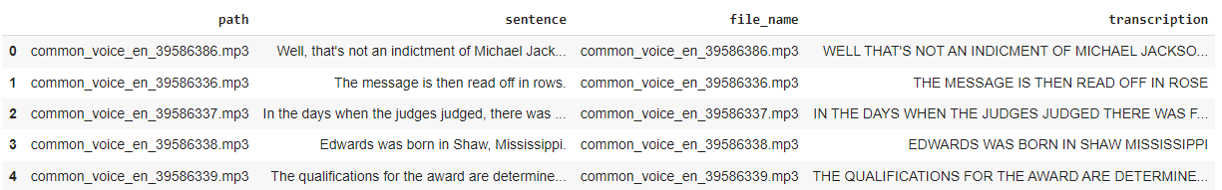
Transcriptions
Step.2: Wav2Vec2 Transcriptions
Language | File Size | Word Error Rate
German | 1262.06 MB | 18.5
Spanish | 1262.08 MB | 17.6
Polish | 1262.08 MB | 24.6
French | 1262.09 MB | 22.1
Portuguese | 1262.1 MB | 27.1
Hindi | 1262.11 MB | 25.2
Dutch | 1262.12 MB | 21.1
Notes:
Word error rate is the metric used to measure the performance of a speech recognition system by comparing the number of errors in the recognized text to the total number of words spoken. Based on the language complexity, phonetic diversity, and grammatical structure, it can affect WER, making some languages inherently more challenging for speech recognition systems.

Slide 18
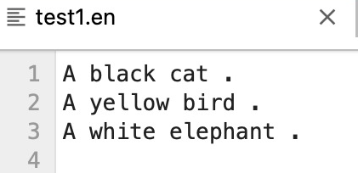
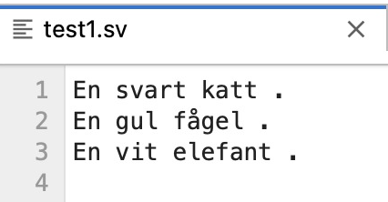
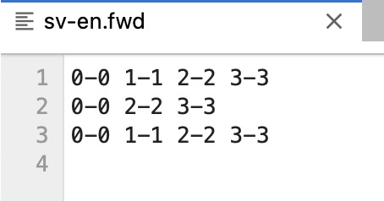
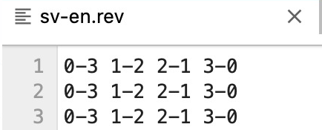
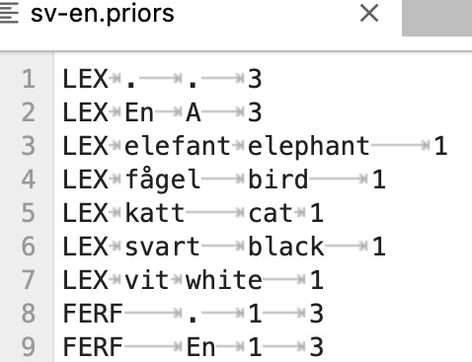
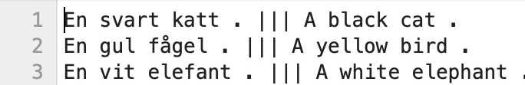
Model Deployment – Transcript Alignment
STEP-3: Alignment with transcripts
English transcript
Swedish transcript
Forward Alignment
Reverse Alignment
Generating Priors
Forward Alignment:
Sequential token mapping from source to target language.
Begins at the start of the text, ensuring linear alignment progression.
Reverse Alignment:
Token mapping from target back to source language.
Starts from the end, offering a backward analysis perspective.
Bilingual Input Requirement:
Requires input files in both languages for analysis.
Eflomal processes these files to determine cross-language token mapping.
Utilizes statistical data to predict token alignments.
Priors act as a reference guide, enhancing alignment accuracy by leveraging historical data.
Notes:
Once we receive outputs from tokenization, these are aligned using the Eflomal model, to ensure synchronization between tokens and the ground truth transcriptions. Common Voice datasets enables us to refine this alignment process, by training the model's capability to accurately interept the linguistic patterns across languages. Our training process involves continuous iteration and refinement as it helps in fine-tuning the model's predictions.
Eflomal maps out the relationships between English and Swedish phrases generating forward and reverse alignment.
Forward Alignment: This involves mapping tokens (like words or phonemes) from a source language to a target language based on a sequential analysis starting from the beginning of the text.
Reverse Alignment: This takes the opposite approach, mapping tokens from the target language back to the source language, starting from the end of the text.
Prior Files: These contain pre-computed probabilities or statistical data that indicate how likely specific tokens (words or phonemes) from the source language are to align with tokens in the target language. You can think of prior files as a cheat sheet that tells the alignment system, "Based on what we've seen before, this word in English usually translates to this word in Spanish."Let's give the EN and SV files as input - then eflomal generates, the forward, reverse and prior files. we need to give both language input files, eflomal tells us which word from one langauge is mapped to the other language

Slide 19
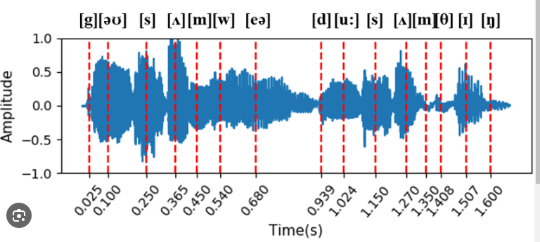
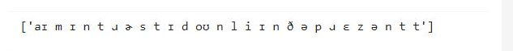
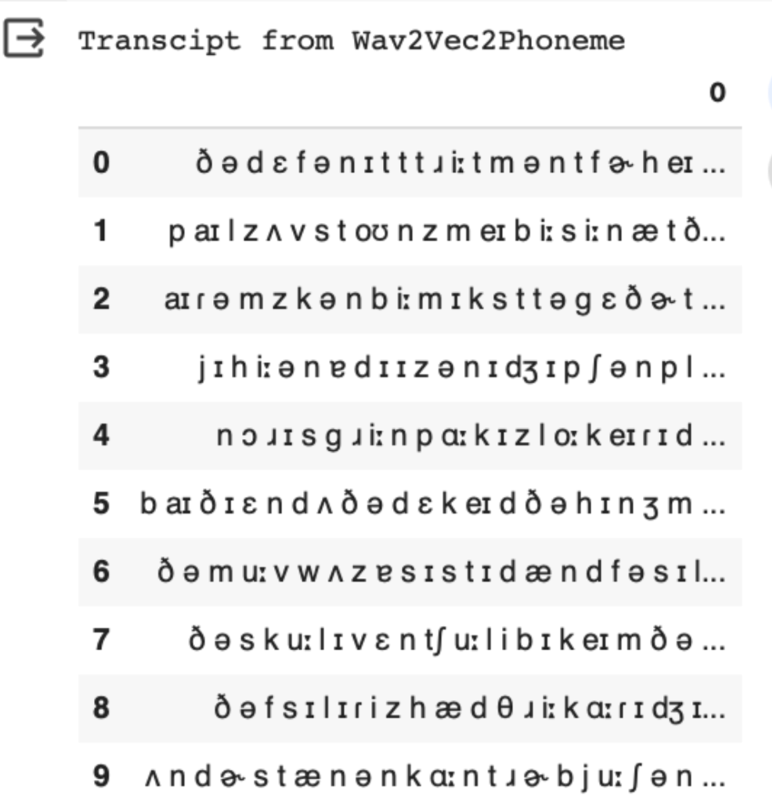
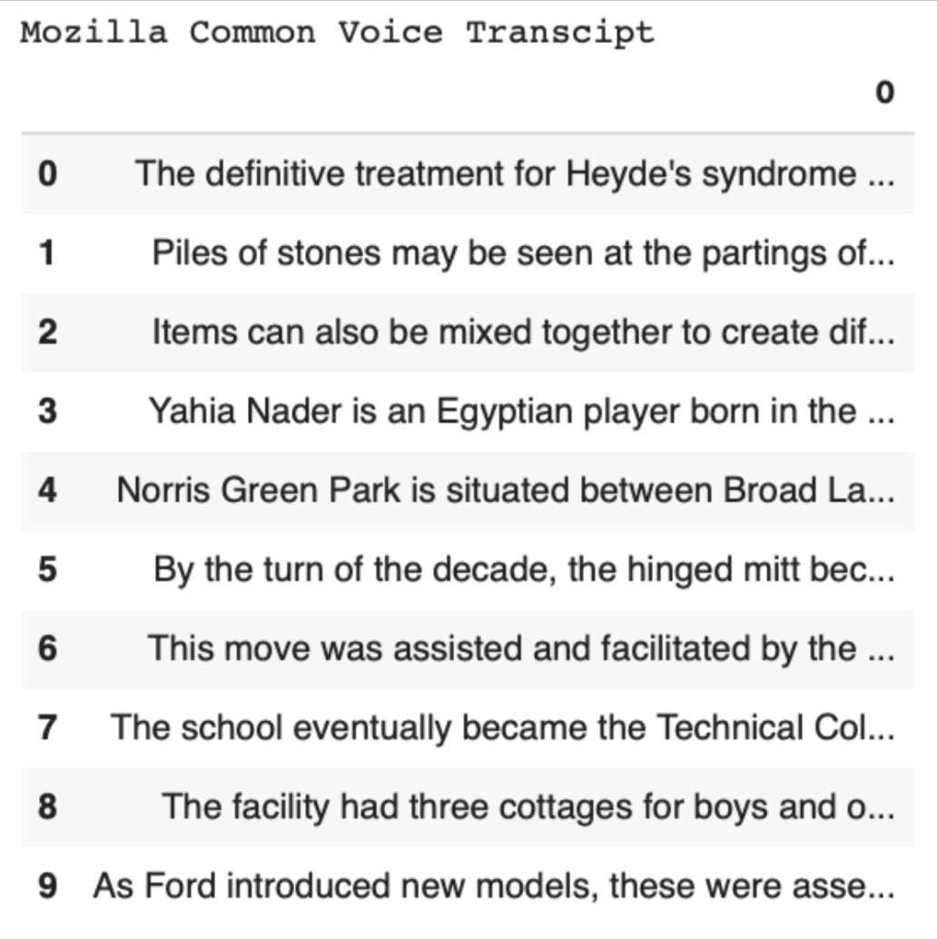
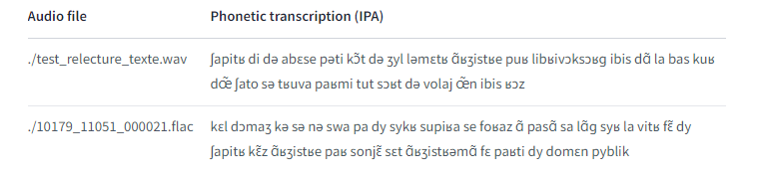
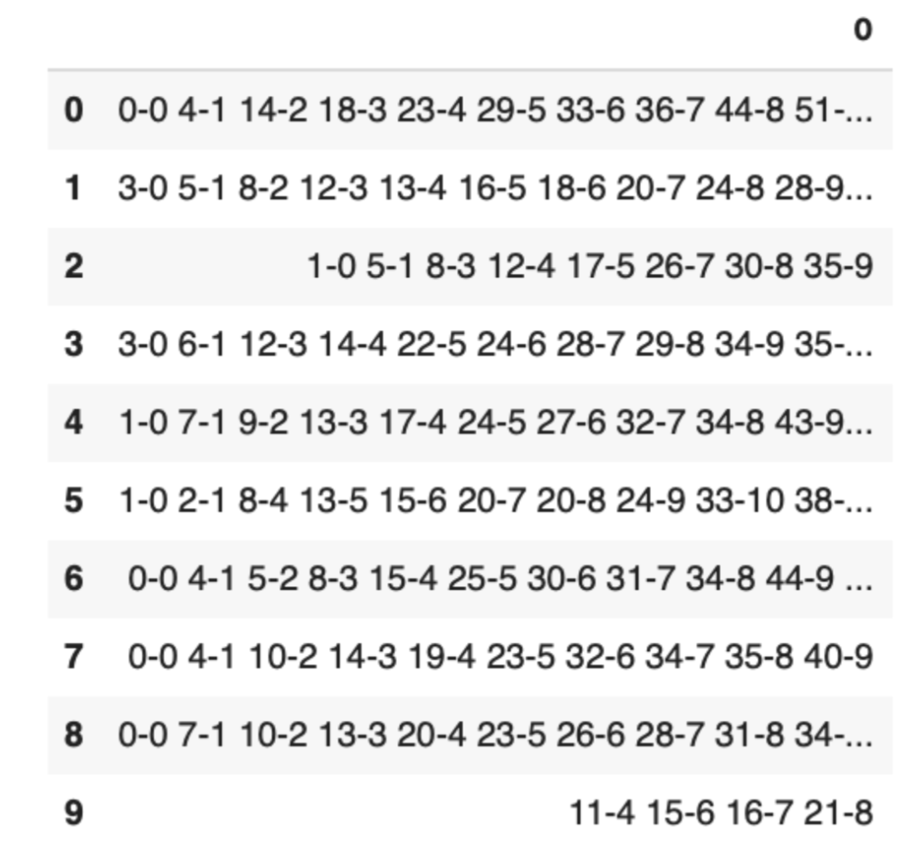
Model
Deployment
STEP-4: Phonemization
Transcript from Wav2Vec2Phoneme
Example of Phoneme recognition Model: Wav2Vec2Phoneme
Ground truth transcripts
"cat”
“/k/, /æ/, /t/”
Forward Alignment
Notes:
Phoneme Recognition: Wav2vec 2.0 phoneme excels in phoneme recognition, using its self-supervised learning approach to process raw audio.
The model outputs a sequence of phonemes. For instance, the word "cat" in English consists of three phonemes: /k/, /æ/, and /t/. The waveform of spoken language is further dissected into phonetic units or phonemes. Each phoneme, marked by vertical lines, corresponds to a single sound in the spoken sentence, providing a visual and quantitative approach to understanding speech.
After phonemization, the next steps involve training models to understand and process the phoneme sequences for various language tasks. Training eflomal using phonemes can improve performance for speech synthesis. That means the next step was to form words out of phonetic symbols by identifying the word breaks and align them with ground truth transcriptions. Using phonemes can make models more agnostic to specific languages, as phonemes are universal to human speech, aiding in the development of multilingual systems.

Slide 20
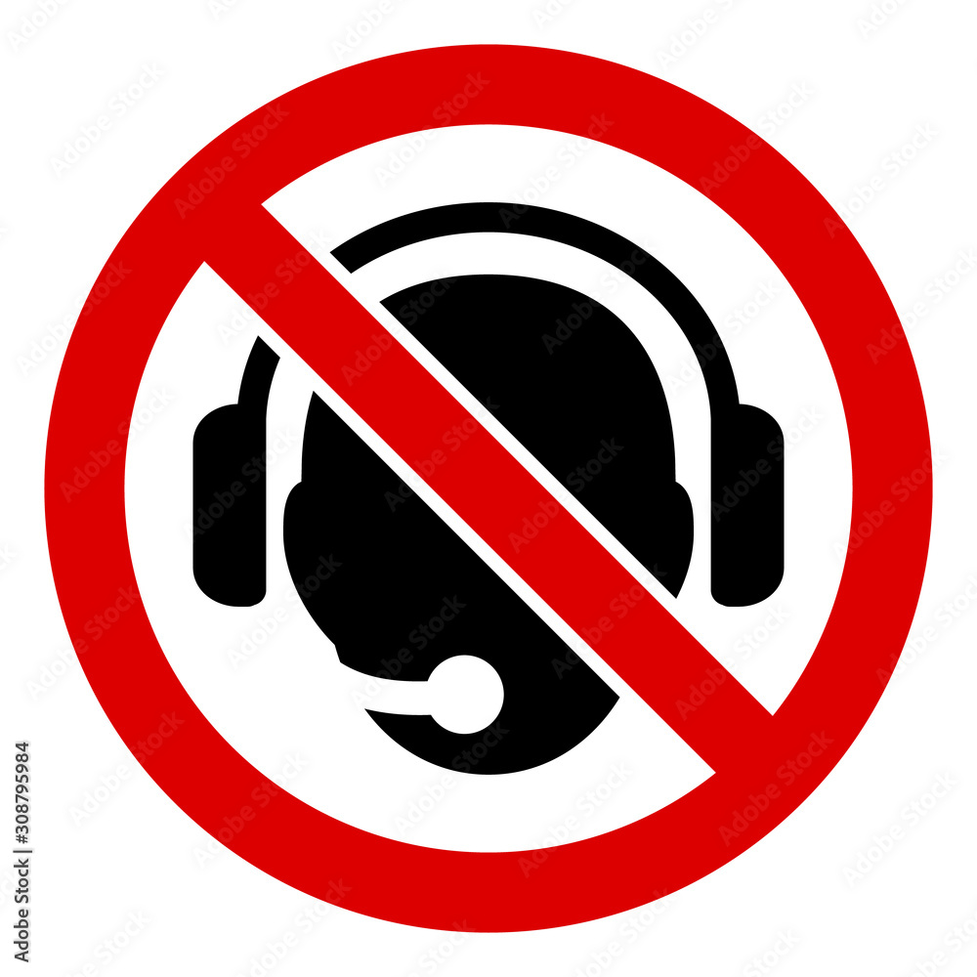
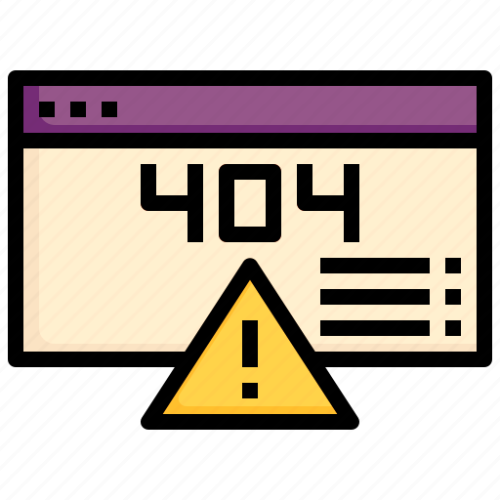

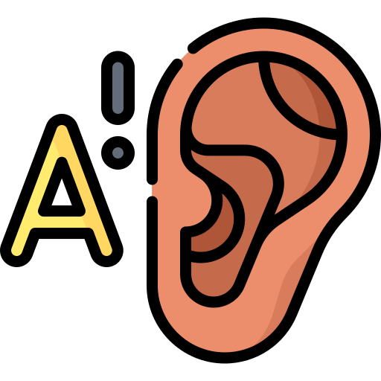

Challenges
Limited or no resources on packages
Packages we had to work with had little to no resources or implementation and support online
Environment Incompatibility
Installing the packages on the configured Sagemaker environment was incompatible with packages being used
Untapped Research Area
Navigating the complexity of accurate audio to text phonetization poses a significant challenge due vast number of languages and dialects
Phoneme Recognition Training
Identify phonemes across diverse languages presents a unique challenge, stemming from the absence of established training guidelines.
Wave2vec2Phoneme word boundaries
Phoneme model is not able to compute word boundaries in output

Slide 21
Experiments and Validation
Experiments
# | Experiment | Dataset | Eflomal | SimAlign
1 | Pre-trained transcription model (English) | 3000 rows | 29% | 50%
2 | Pre-trained transcription model + Transliteration (Hindi) | 3000 rows | 35% | 38%
3 | Language agnostic Phonetic model (English) | 1000 rows | 98%* | 99%*
4 | Language agnostic Phonetic model (English) | 3000 rows | 97%* | 98%*
unalignment_ratio = (total_unaligned / sentence_length) * 100
Where total_unaligned is the sum of number of words from target that are left unaligned to the source (missing words) and the number of words left unaligned from source to the target (the padding/extra words)
Validation Metric – Unalignment rate
* For the Phonetic model, unalignment_ratio was calculated on the basis of number of unaligned words per sample after manual validation

Slide 22

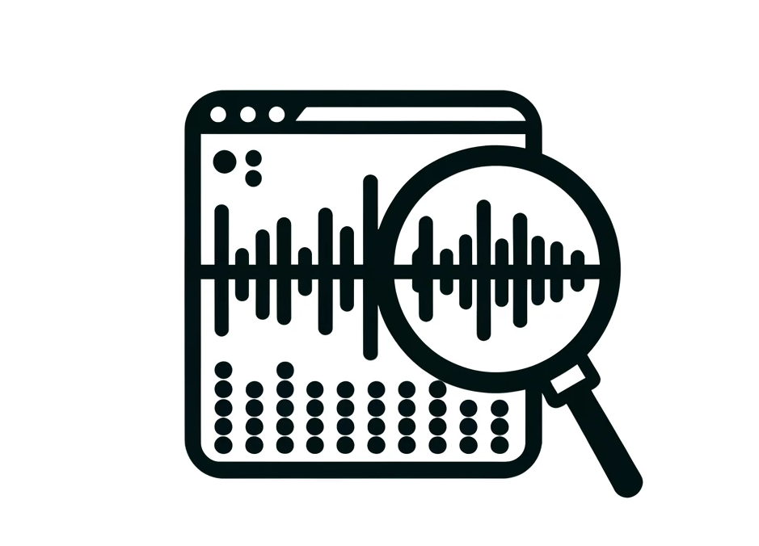

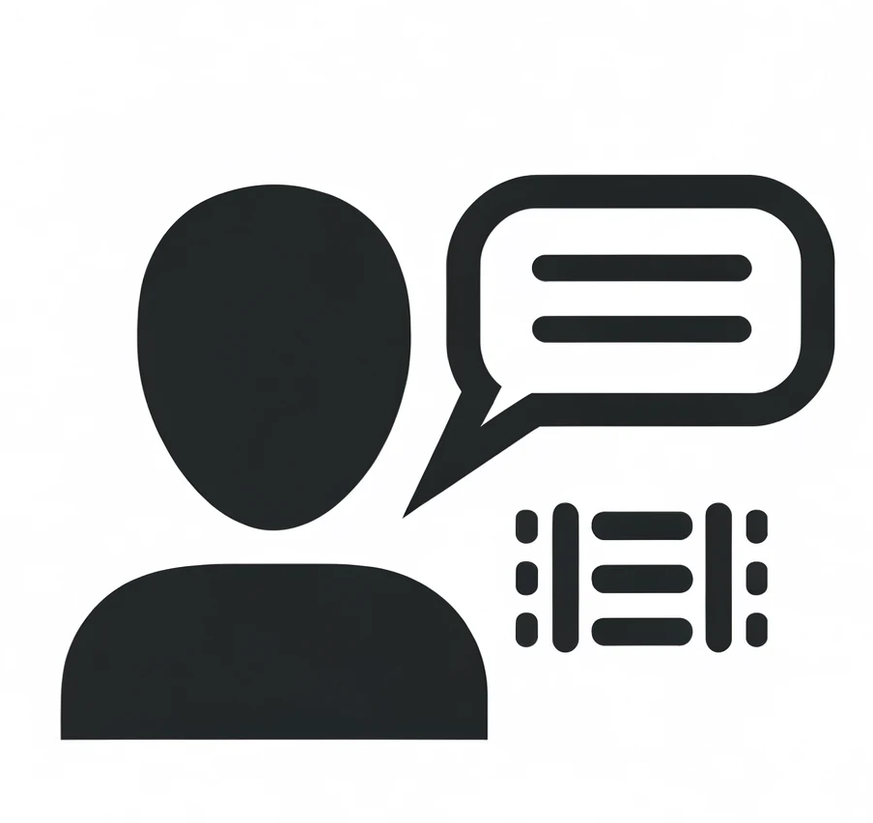
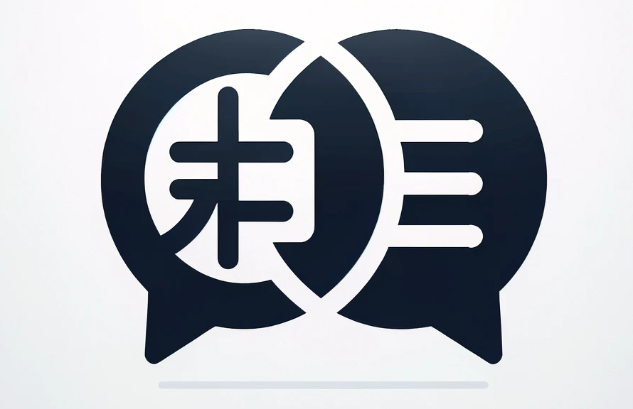
Future Scope
Future scope of this project lies in developing multilingual alignments .
Steps that can be taken to further this project:
Test the method on non-monotonic monolingual audio .
Explore cross-lingual alignment,
Gather data for
target languages.
Simulate real-life scenarios
Notes:
Our project has developed a model for audio to text alignment, in three languages, English, French and Hindi.
Given the limited time we were able to only perform monotonic monolingual alignment.
Future scope of this project lies in developing multilingual alignments and successfully being able to convert audio from one language into written form of another and thus being able to break the language barriers in the fields of Education
Testing the method on non-monotonic monolingual audio to evaluate its effectiveness across different audio types.
Cross-lingual alignment: where audio in one language is aligned with text in another, to gauge the method's versatility and adaptability.
Assessing the impact of imputing missing audio segments to simulate real-life scenarios and improve the robustness of the method.
Collaboration with communities speaking the target languages will be crucial for gathering data and ensuring the technology meets their needs effectively.
Simulate real-life scenarios and improve the robustness of the method

Slide 23
Thank You

